Slide 1
KIDS ENGLISH CLUB

Slide 2
Fun in the park

Slide 3
1
What can you see in the park?
Look and answer the question

Slide 4
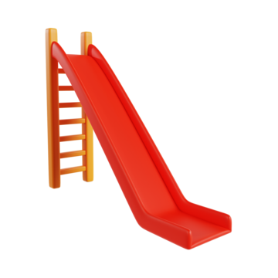
1. What is it?
A slide
A swing
A see-saw

Slide 5
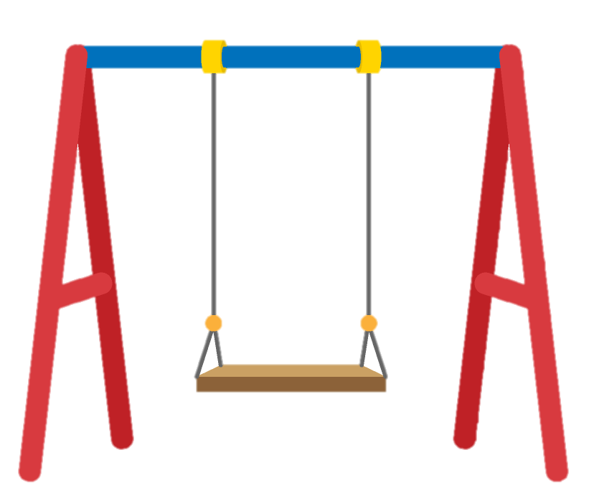
2. What is it?
A swing
A merry-go-round
A bench

Slide 6
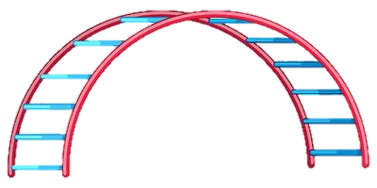
3. What is it?
A jungle gym
A monkey bar
A bridge

Slide 7
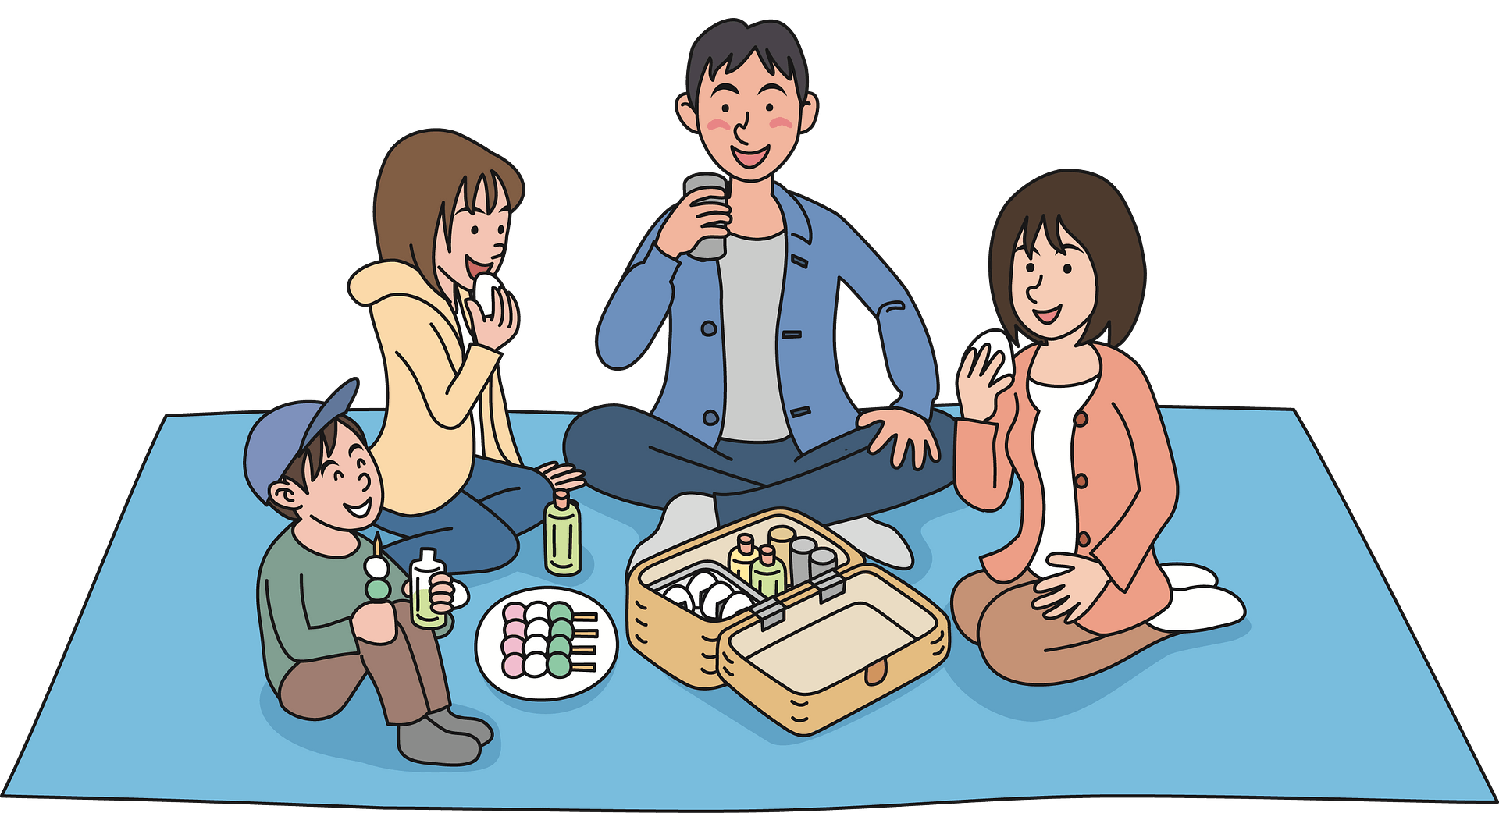
4. What do they like to do in the park?
Sit on a park bench
Play on the slide
Have a picnic

Slide 8
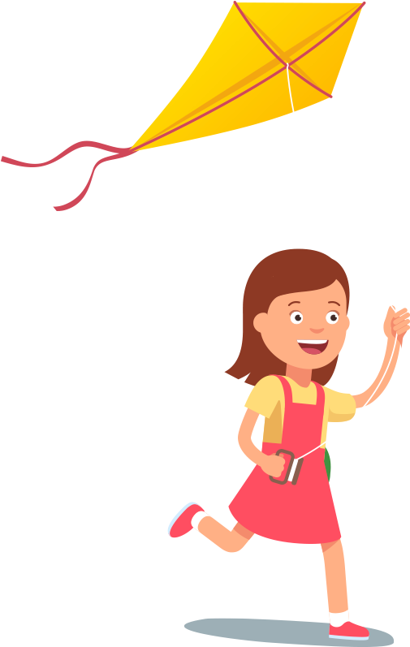
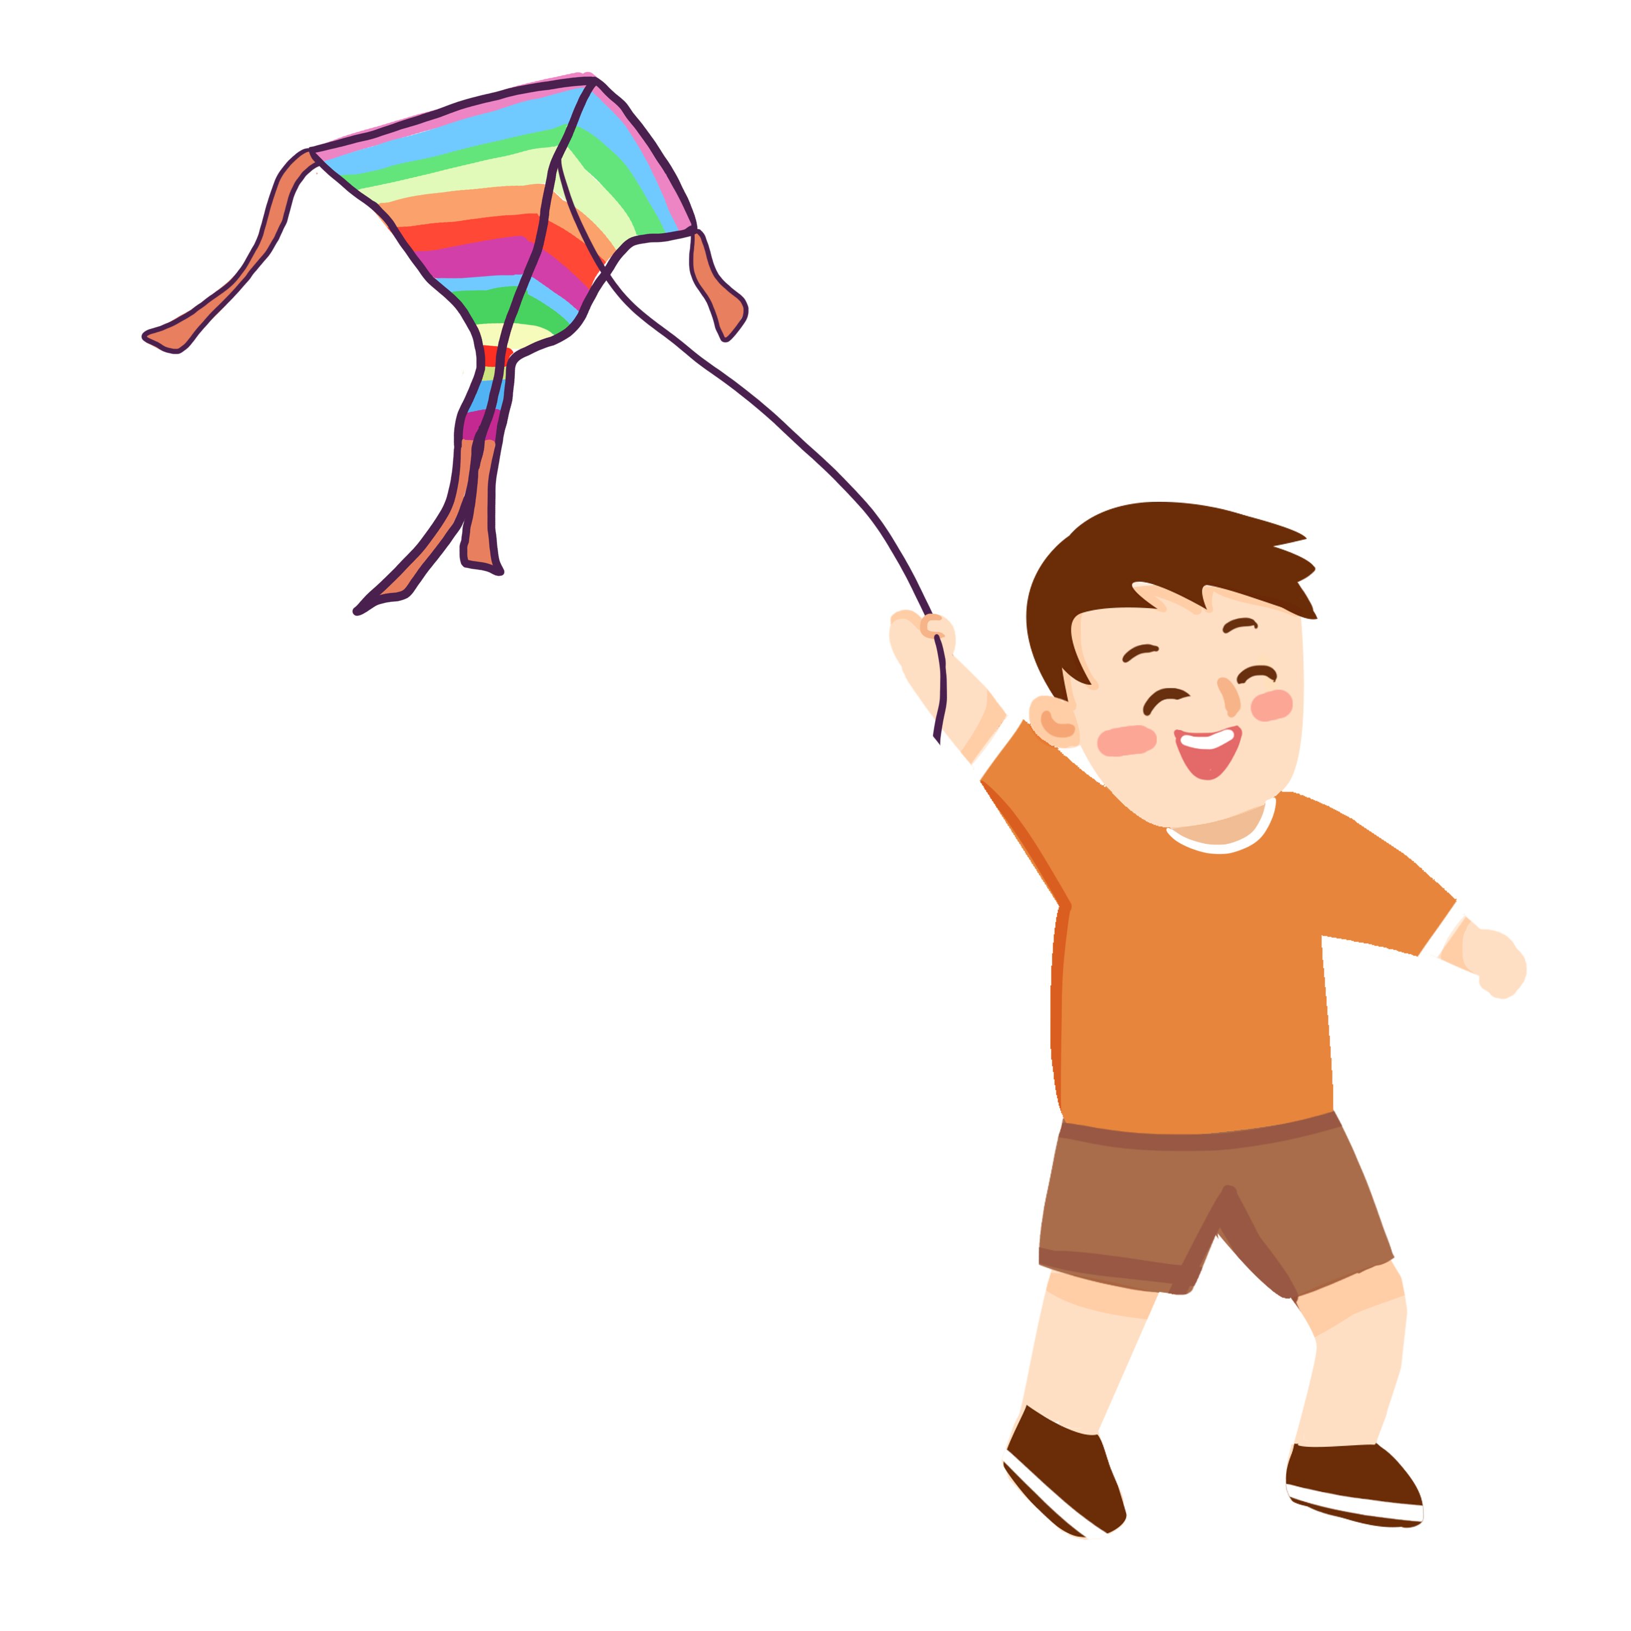
5. What do they like to do in the park?
Fly a kite
Walking
Jogging

Slide 9
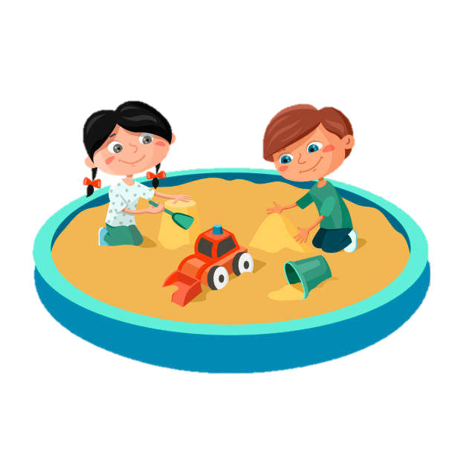
6. What do they like to do in the park?
Play on the swing
Play in the sandbox
Play on the see-saw

Slide 10
02
Conversation questions
Share your opinions

Slide 11
1
Is there a park near your house?
2
How often do you go to the park?
3
What activities do you enjoy doing in parks?
4
What’s your favorite season to visit the park?
5
Is there anywhere to buy something to eat in the park?
6
Park rules - What you must and mustn’t do in a park.

Slide 12
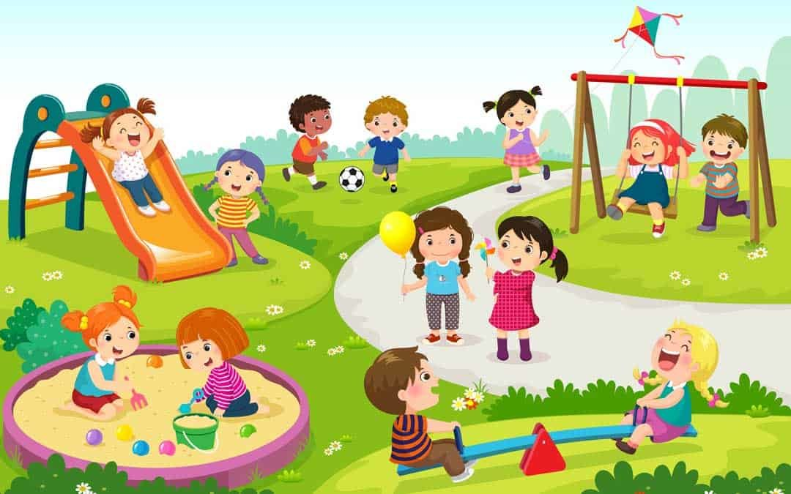
Describe the pictures
Jack
Mason
Lucy
Amy
How many children are playing in the sandbox?
What are Harry and Mia doing?
What is Ava holding?
What sport are Jack and Mason playing?
What is Lucy doing?
Anna
Joe
Oscar
Daisy
Ava
Ella
Holly
Mia
Harry

Slide 13
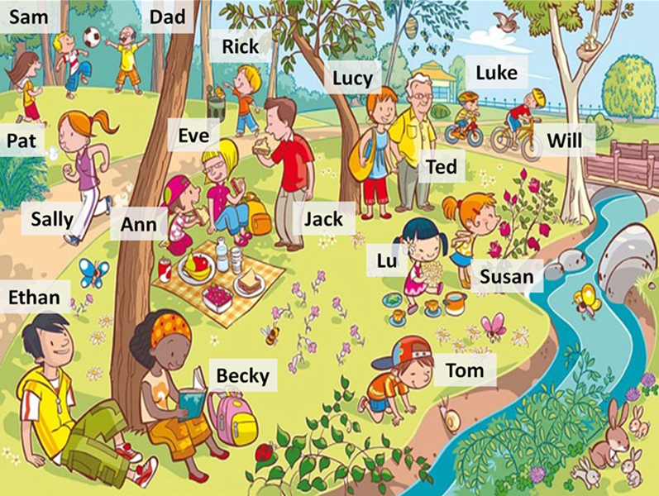
Describe the pictures
What is Jack eating?
What are Luke and Will doing?
Are there rabbits in the park?
Is Rick throwing the litter on the ground?
Is Sally walking?

Slide 14
Good job!

Slide 15
Thanks
Do you have any questions?

Slide 16
It’s time to go outside!

